Slide 1


Centre for Development of Telematics
Introduction to gRPC
High-Performance Remote Procedure Call (RPC) Framework
1
Partha BP

Slide 2
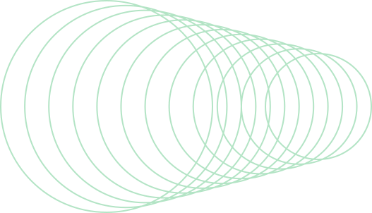
Agenda
Why RPC
Introduction to gRPC
gRPC
gRPC VS TCP
Implementation
2

Slide 3

What is RPC? (Remote Procedure Call)
RPC (Remote Procedure Call) allows a program to execute functions on a remote server as if they were local.
It hides the complexity of networking, making remote communication feel like a function call.
How RPC Works?
Client calls a remote function (like a normal function call).
The request is serialized and sent over a network.
Server processes the request and sends a response.
The response is deserialized on the client side.
3

Slide 4

Introduction to gRPC
gRPC is a modern, high-performance Remote Procedure Call (RPC) framework developed by Google.
It uses Protobuf, HTTP/2, and advanced streaming.
Key Features of gRPC:
Supports multiple programming languages.
Uses Protocol Buffers (Protobuf) for compact, fast serialization.
Enables real-time streaming and bidirectional communication.
Uses HTTP/2 for better performance & reduced latency.
Built-in authentication & security.
4

Slide 5
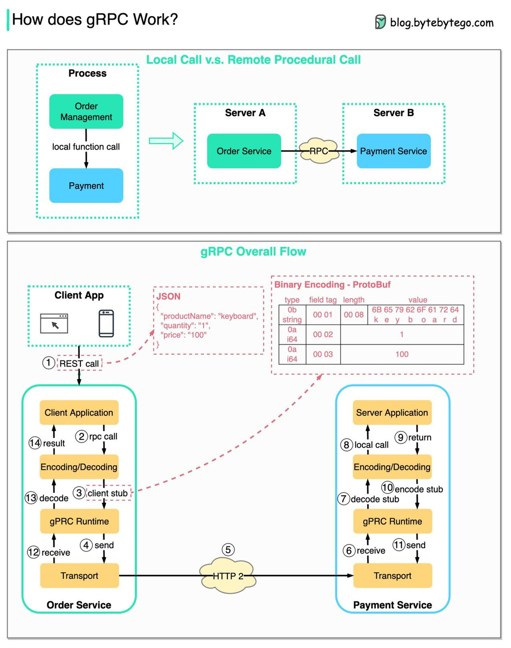

5

Slide 6
gRPC vs TCP
1. Structured API Instead of Raw Byte Streams
Issue with TCP : Transmits raw bytes, requiring manual parsing.
gRPC Advantage : Uses Protobuf, automatically serializes/deserializes structured data
Example: IoT Sensor Data
TCP: Sensor sends raw bytes, server manually decodes.
gRPC: Sensor sends structured Protobuf, server decodes instantly.
2. HTTP/2 vs. TCP
Issue with TCP (HTTP/1.1) : Sends one request at a time per connection (slow for multiple requests).
gRPC Advantage : Allows multiple parallel requests over one connection.
Example: E-commerce Website (Amazon)
TCP: Fetching product details, reviews, and recommendations is sequential (slower).
gRPC: All requests happen simultaneously (faster page load)
6

Slide 7
gRPC vs TCP
3. Serialization Format (Why Protobuf is Better Than JSON)
TCP: JSON/XML is human-readable but large, making it slower to transmit.
Includes unnecessary metadata (e.g., field names "name", "age").
gRPC (Protobuf Serialization):
Uses binary encoding, making it compact & efficient.
Faster parsing and low latency due to smaller size.
JSON (TCP-Based APIs, 100+ Bytes)
{
"name": "Alice",
"age": 25,
"city": "Bangalore"
Binary Output
00001010 05 41 6c 69 63 65 10 19 1a 09 42 61 6e 67 61 6c 6f 72 65 (~20 bytes)
7

Slide 8
Implementation
Step 1: Define the Service (gRPC Contract – .proto file)
Before the client and server talk, they need a common language.
This is done using Protocol Buffers (Protobuf).
Think of it as a menu in a restaurant
syntax = "proto3";
service Greeter {
rpc SayHello (HelloRequest) returns (HelloReply);
}
message HelloRequest {
string name = 1;
}
message HelloReply {
string message = 1;
}
Here, SayHello() is like a function where the client sends a name, and the server responds with a greeting.
8

Slide 9
Implementation
Step 2: Implement the gRPC Server
import grpc
from concurrent import futures
import hello_pb2
import hello_pb2_grpc
# Implement the Greeter serviceclass Greeter(hello_pb2_grpc.GreeterServicer):
def SayHello(self, request, context):
return hello_pb2.HelloReply(message=f"Hello, {request.name}!")
# Set up and start the gRPC server
server = grpc.server(futures.ThreadPoolExecutor(max_workers=10))
hello_pb2_grpc.add_GreeterServicer_to_server(Greeter(), server)
server.add_insecure_port('[::]:50051') # Listen on port 50051
server.start()
print("Server started. Listening on port 50051...")
server.wait_for_termination()
🔹 How It Works?
Server listens for requests on port 50051.
When the client sends "Partha", the server responds "Hello, Partha!".
9

Slide 10
Implementation
Step 3: Implement the gRPC Client
import grpc
import hello_pb2
import hello_pb2_grpc
# Connect to the gRPC server
channel = grpc.insecure_channel('localhost:50051')
stub = hello_pb2_grpc.GreeterStub(channel)
# Send a request to the server
response = stub.SayHello(hello_pb2.HelloRequest(name="Partha"))
print("Server Response:", response.message)
🔹 How It Works?
The client connects to the server (localhost:50051).
Calls the SayHello() function with the name "Partha".
Receives "Hello, Partha!" from the server.
10

Slide 11
Conclusion
Fast & Efficient: Uses Protobuf (binary format) instead of JSON, reducing size & improving speed.
Multiplexing with HTTP/2: Handles multiple requests simultaneously, unlike traditional TCP.
Built-in Streaming: Supports client, server & bidirectional streaming for real-time data.
Cross-Language Support: Works with Python, Java, C++, Go, and more.
Secure Communication: Includes TLS encryption & authentication out of the box.
Better Than REST APIs & TCP: Optimized for microservices & high-performance systems.
gRPC is the future of fast, scalable, and secure communication!
11

Slide 12
THANK YOU

